Slide 1


HEART FAILURE PREDICTION Machine Learning
Supervised By:
Prof. Dr. Hala Zayed
Eng. Abdulwahab Almestekawy
Team Members:
Rana Farid Shawky.
Rola Hossam El-Din.
Rawan Hossam Ibrahim.
Abdel Moniem Elsayed Abdel Moniem.

Slide 2
Problem Overview
• Heart failure is a common event caused by CVDs and this dataset contains 12 features that can be used to predict mortality by heart failure.
• By applying some machine learning models on those input features we can get an accurate classification of them.
• Our inputs (features): age, anaemia , creatinine_phosphokinase , diabetes , ejection_fraction , high_blood_pressure , platelets , serum_creatinine , serum_sodium , sex, smoking and time.
• Output feature: DEATH_EVENT which must be classified to predict possibility of death .

Slide 3
Dataset
The dataset used is the “Heart Failure Clinical Records”
available at the following link:
https://www.kaggle.com/andrewmvd/heart-failure-clinical-data
We analyzed a dataset containing the medical records of 299 heart failure patients that consisted of 105 women and 194 men, and their ages range between 40 and 95 years old . The dataset contains 13 features, which report clinical, body, and lifestyle information. So, This dataset is predicting heart failure disease by classification of some features.
Methods
we analyze a dataset of 299 patients with heart failure collected in 2015. We apply several machine learning classifiers to both predict the patients survival, and rank the features corresponding to the most important risk factors.

Slide 4
1) Data pre-processing
Data pre-processing in Machine Learning is a crucial step that helps enhance the quality of data to promote the extraction of meaningful insights from the data. In simple words, data pre-processing in Machine Learning is a data mining technique that transforms raw data into an understandable and readable format.
have only one problem which need to be pre-processed is that values of features are in very different ranges so we will apply feature scaling that limits the range of variables so that you can compare them on common grounds.
2) Decision Tree
Is a type of Supervised Machine Learning (that is you explain what the input is and what the corresponding output is in the training data) where the data is continuously split according to a certain parameter. The tree can be explained by two entities, namely decision nodes and leaves.

Slide 5
3) Logistic Regression
Logistic Regression is a Machine Learning algorithm which is used for the classification problems, it is a predictive analysis algorithm and based on the concept of probability. It is fast and relatively uncomplicated, and it’s convenient for you to interpret the results. Although it’s essentially a method for binary classification, it can also be applied to multiclass problems.
4) Support Vector Machine
The goal of SVM is to design a hyperplane that classify all training vectors into two classes.
The best choice will be the hyperplane that leaves the maximum margin .
In addition to performing linear classification, SVMs can efficiently perform a non-linear classification using what is called the kernel trick (Polynomial-Gaussian- Sigmoid), implicitly mapping their inputs into high-dimensional feature spaces.
For our project we used three kernels for SVM:
(Polynomial SVM , Linear SVM , RBF SVM )

Slide 6
5) Ensemble Learning
It is the process by which multiple models, such as classifiers or experts, are strategically generated and combined to solve a particular computational intelligence problem. Ensemble learning is primarily used to improve the (classification, prediction, function approximation, etc.).
For our project we used three models for ensemble learning:
(Voting Classifier - Bagging Classifier -Random Forest Classifier) .

Slide 7
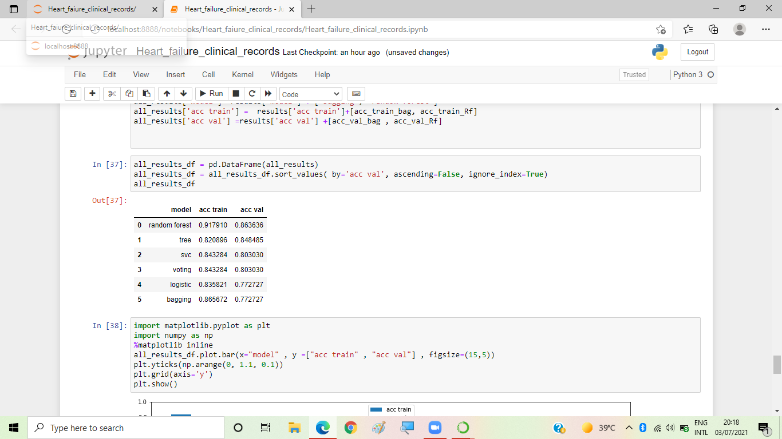
Results
For the best model (random forest): The accuracy of training of the model is 91% and the accuracy of validation Is 86%.
Accuracy score for the final Testing: 0.9191919191919192%

Slide 8
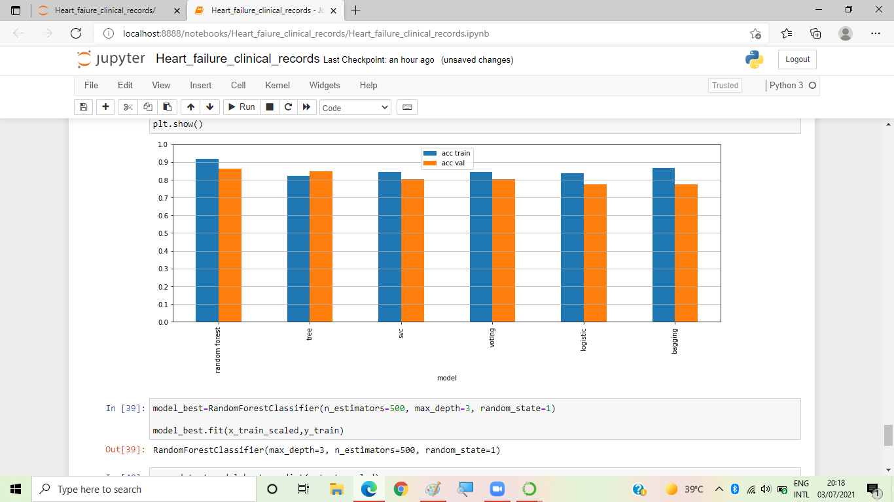

Slide 9
Conclusion
In our work, the fact that our traditional biostatistics analysis selected ejection fraction and serum creatinine as the two most relevant features confirmed the relevance of the feature ranking executed with machine learning. Moreover, our approach showed that machine learning can be used effectively for binary classification of electronic health records of patients with cardiovascular hearth diseases. Our models are Logistic regression, Data Pre-processing, Feature Scaling, Decision Tree, Support Vector Machine and Ensemble Learning . The accuracy of our model is 0.919%.
As a limitation of the present study, we have to report the small size of the dataset (299 patients): a larger dataset would have permitted us to obtain more reliable results. Additional information about the physical features of the patients (height, weight, body mass index, etc.) and their occupational history would have been useful to detect additional risk factors for cardiovascular health diseases. Also, if an additional external dataset with the same features from a different geographical region had been available, we would have used it as a validation.

Slide 10
References
[1] The Guardian. UK heart disease fatalities on the rise for first time in 50 years. https://www.theguardian.com/society/2019/may/13/heart-circulatory-disease-fatalities-on-rise-in-uk. Accessed 25 Oct 2019.
[2] National Heart Lung and Blood Institute (NHLBI). Heart failure. https://www.nhlbi.nih.gov/health-topics/heart-failure. Accessed 20 June 2019.
[3] Polikar, R. (n.d.). Ensemble learning. Scholarpedia. http://www.scholarpedia.org/article/Ensemble_learning.

